Slide 1
Dog bites on the decline in Louisville
Blaine Murphy

Slide 2
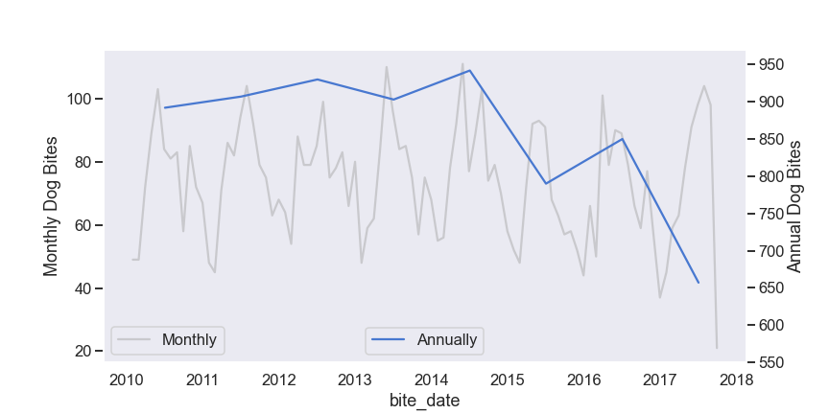
Despite recent cases, Dog Bites are trending down

Slide 3
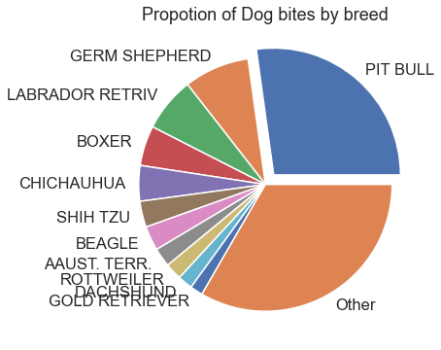
To reduce risk, exercise caution around dangerous breeds
The chance of getting rabies following a dog bite is only 0.014%!

Slide 4
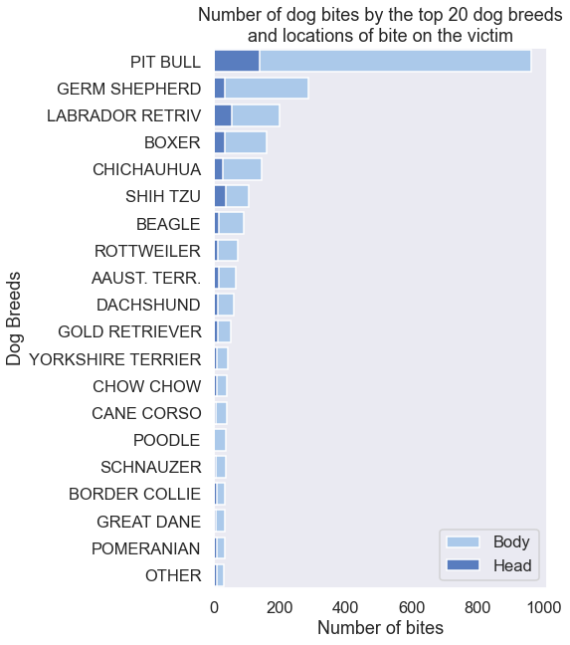
To reduce risk, exercise caution around certain breeds
But it’s not just big dogs…

Slide 5

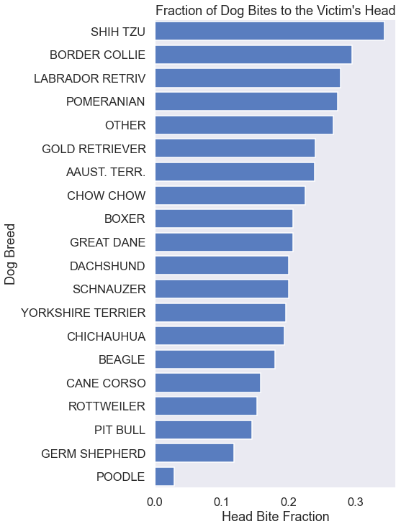
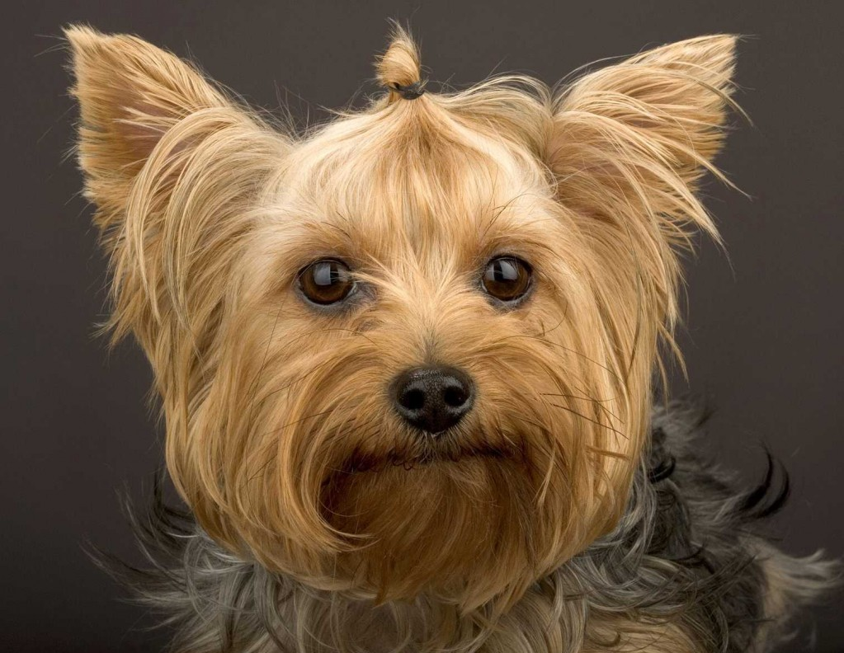


They may be cute…
…but smaller dogs have a propensity for biting victims in the head.

Slide 6
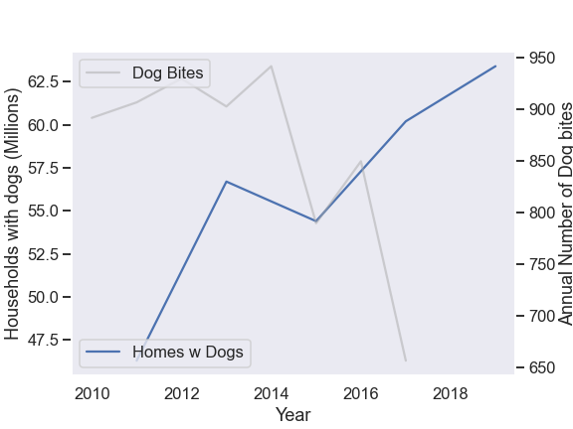
Good news! Bite rate declining in spite of growing number households with dogs
From American Pet Products Association National Survey

Slide 7
Residents of Louisville
Dog bite incidents are on the decline in spite of an increase in the number of households with dogs.
To continue this trend ensure that that your pets:
Are well fed
Are well trained
Get plenty of exercise
Get the opportunity to socialize, especially when young
To reduce risk exercise caution when encountering Pit Bulls and German Shepherds
The chance of getting rabies following a dog bite is only 0.014%!

